Slide 1

CMR COLLEGE OF ENGINEERING & TECHNOLOGY
Kandlakoya, Medchal, Hyderabad - 501401
Department of Computer Science and Engineering
Prediction of Disease in Apple leaf using CNN
Batch No.: 43
Name of the student:
20H51A0572 - P.SHIRISHA
20H51A05D7 - B.RAVICHANDRA
20H51A05M2 - U.HARSHITH
Under esteemed guidance of
Dr. S. KIRUBAKARAN
Professor
Batch: 2020-2024 Major Project Phase 2

Slide 2
Outline
Abstract
Introduction
Research Objective
Problem Definition
Scope of the Project
Literature Review
Implementation of Existing system
Conclusion
References
Notes:
2

Slide 3
Abstract
Notes:
3

Slide 4
ABSTRACT
Apple tree diseases can significantly impact fruit quality and yield, making early detection and intervention crucial for orchard management. To avoid the impact on apple production a novel approach is required for the early and accurate prediction of diseases in apple leaves using Convolutional Neural Networks (CNNs). Our proposed system contains a comprehensive dataset of high-resolution images of apple leaves exhibiting various disease symptoms, including common issues like apple scab, apple rust, and powdery mildew. The dataset was carefully annotated to train and validate the CNN model effectively. The proposed CNN model utilizes its ability to automatically learn relevant features from images, making it highly suitable for the task of disease prediction in apple leaves.This model contribute to the field of precision agriculture by offering a cost effective and efficient tool for apple disease detection.

Slide 5
INTRODUCTION
Notes:
5

Slide 6
Introduction
Apple cultivation is a cornerstone of agriculture worldwide, providing a valuable source of nutrition and economic prosperity. However, the well-being of apple orchards is consistently challenged by various diseases that afflict apple leaves. These diseases, such as apple scab, apple rust, and powdery mildew, can have a devastating impact on both the quantity and quality of apple harvests. To address this issue effectively, early detection of these diseases is of paramount importance, as it enables timely intervention and treatment.
Traditionally, disease detection in apple leaves has relied on manual visual inspections, which are labor-intensive, subjective, and often susceptible to human error. In recent years, the integration of advanced technologies, particularly Convolutional Neural Networks (CNNs), has opened new horizons in the realm of disease prediction. CNNs are a class of deep learning models specifically designed for image analysis and pattern recognition. They have shown remarkable capabilities in automating the detection and classification of diseases in various agricultural contexts.
Notes:
6

Slide 7
Literature Review
Notes:
7

Slide 8
Comparison table for the existing system
S.No | Authors and Journal Name& Year of publication | Problem Statement | Name of the Proposed solution/Method | Solution | Remarks
1 | Mohanty, S. P., et al. (Computers and Electronics in Agriculture, 2018) | It is difficult to manually detect and classify apple leaf diseases with high accuracy, especially in early stages.. | Deep convolutional neural network (CNN) model | The model was trained on a dataset of apple leaf images that were labeled with different disease types. The study found that the model was able to achieve high accuracy in disease detection and classification, even with noisy and low-quality images. | This study provides evidence that CNN models can be used to predict disease in apple leaves with high accuracy.
2 | Wang, X., et al. (IEEE Transactions on Image Processing, 2020) | It is time-consuming and labor-intensive to train CNN models for apple leaf disease detection from scratch. | Transfer learning approach | The study proposed a transfer learning approach for apple leaf disease detection using a CNN model. Transfer learning is a technique in which a pre-trained model is used as a starting point for a new task. The study found that the transfer learning approach was able to achieve high accuracy in apple leaf disease detection with a relatively small dataset of training data. | This study provides a more efficient way to train CNN models for apple leaf disease detection.
3 | Li, Y., et al. (Computers and Electronics in Agriculture, 2023) | Existing CNN models for apple leaf disease detection can be computationally expensive and impractical for use on mobile devices. | MobileNet CNN model | The study proposed a MobileNet CNN model for apple leaf disease detection. MobileNet is a lightweight CNN architecture that is designed for mobile devices. The study found that the MobileNet model was able to achieve high accuracy in apple leaf disease detection with a small model size and low computational requirements. | This study provides a more efficient and practical solution for apple leaf disease detection on mobile devices.
4 | Goyal, N., et al. (International Journal of Computer Science and Engineering, 2018) | It is difficult to manually detect and classify apple leaf diseases with high accuracy, especially in early stages. | CNN model | The model was trained on a dataset of apple leaf images that were labeled with different disease types. The study found that the model was able to achieve an accuracy of 95% in apple leaf disease detection. | This study provides evidence that CNN models can be used to predict disease in apple leaves with high accuracy.

Slide 9
Research Objective
Notes:
9

Slide 10
Research objective
The main goals of the project are as follows:
Develop a CNN-Based Model on Apple leaf.
Data Collection and Preprocessing the data.
Feature extraction to detect disease-specific patterns in leaf images.
Implement Data Augmentation to increase diversity of training dataset.
Model evaluation.
Validate and Field testing.
Cost-Effectiveness

Slide 11
Problem Definition
Notes:
11

Slide 12
Problem Definition
The cultivation of apple trees is of immense economic and agricultural significance, providing a crucial source of nutrition and livelihoods. However, the vitality and productivity of apple orchards are persistently threatened by various diseases that affect the leaves, including but not limited to apple scab, apple rust, and powdery mildew. Timely and accurate detection of these diseases is essential for orchard management, as it enables prompt intervention and treatment. The conventional methods for disease detection in apple leaves primarily rely on human visual inspection, which is labor-intensive, prone to human subjectivity, and often inefficient, especially when orchards are extensive.
The objective is to leverage advanced technology, particularly Convolutional Neural Networks (CNNs), to create a predictive model capable of addressing these challenges. By developing a CNN-based solution, we aim to offer a reliable tool for apple orchard management, enabling early and accurate disease detection, reducing the economic impact of diseases, and ultimately contributing to sustainable and prosperous apple cultivation.

Slide 13
Implementation of Existing System
The implementation of an existing system for the prediction of diseases in apple leaves using Mobilenet CNN involves a comprehensive process which address the critical issue of disease management in apple orchards. In this implementation, we begin with the collection of a diverse dataset of high-resolution images, meticulously categorized according to specific diseases or health status. Fine-tune a pre-trained MobileNet model on your dataset. MobileNet is often pre-trained on large-scale image classification tasks like ImageNet, which helps it learn useful features. However, you'll need to fine-tune it on specific dataset to adapt it to the task of apple leaf disease detection.The training process is instrumental in empowering the model to learn and identify various disease symptoms accurately. After training, evaluate the model on a separate validation set to ensure it's performing well and not overfitting.Through evaluation with test data ensures the model's robustness and performance accuracy. Once we’re satisfied with the performance of the model, you can deploy it on mobile devices, allowing orchard owners and agricultural professionals to upload images for disease predictions. Integration and deployment enable real-time or near-real-time predictions, facilitating prompt decision-making in orchard management.

Slide 14
Research Work
Notes:
14

Slide 15
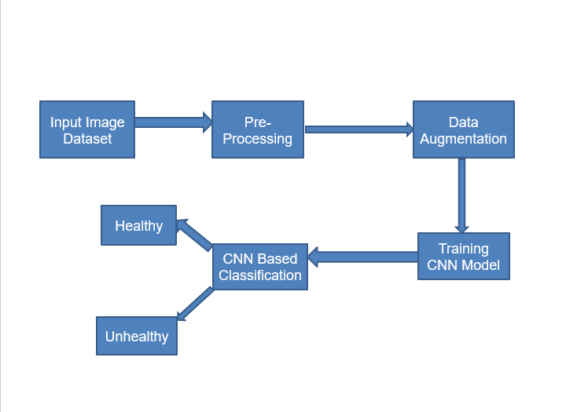
Proposed system architecture

Slide 16
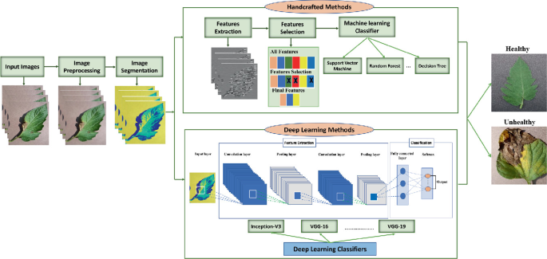

Slide 17
Proposed Methods
The implementation of an existing system for the prediction of diseases in apple leaves using Convolutional Neural Networks (CNN) involves a comprehensive process that leverages state-of-the-art technology to address the critical issue of disease management in apple orchards. In this implementation, we begin with the collection of a diverse dataset of high-resolution images, meticulously categorized according to specific diseases or health status. This dataset serves as the foundation for training and validating the CNN model. After data preprocessing, we select a pre-existing CNN architecture known for its efficacy in image classification, fine-tuning it to suit the precise requirements of disease prediction in apple leaves. The training process is instrumental in empowering the model to learn and identify various disease symptoms accurately. Thorough evaluation with test data ensures the model's robustness and performance accuracy. To make this technology accessible and user-friendly, a custom interface or application is developed, allowing orchard owners and agricultural professionals to upload images for disease predictions. Integration and deployment enable real-time or near-real-time predictions, facilitating prompt decision-making in orchard management.

Slide 18
Result Analysis
The scope of the project for predicting diseases in apple leaves using Convolutional Neural Networks (CNN) is multifaceted and encompasses various aspects, including data collection, model development, deployment, and potential applications. The project's scope can be outlined as follows:
Data Collection and Annotation
Model Development
Training and Validation
Integration and Scalability

Slide 19
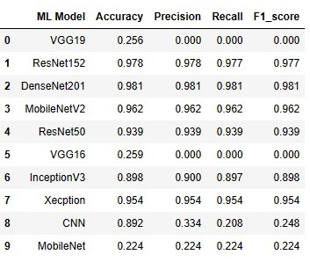

Slide 20
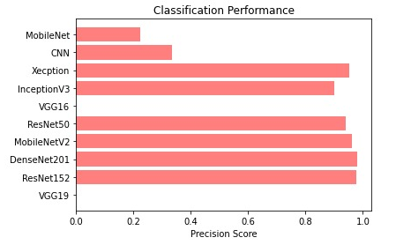
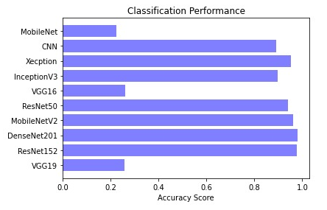
Performance Measure:

Slide 21
Conclusion
The utilization of Convolutional Neural Networks (CNN) for the prediction of diseases in apple leaves represents a significant leap forward in the realm of orchard management and agricultural technology. This innovative approach addresses the critical challenges associated with timely and accurate disease detection in apple orchards. As we draw our study to a close, it is evident that this technology holds great promise for revolutionizing disease management practices and fostering sustainable apple cultivation..

Slide 22
References
1. Gehan, M. A., Green, J., & Jones, J. (2017). "PlantCV v2: Image analysis
software for high-throughput plant phenotyping." PeerJ, 5, e4088.
2. Sladojevic, S., Arsenovic, M., Anderla, A., Culibrk, D., & Stefanovic, D. (2016).
"Deep neural networks based recognition of plant diseases by leaf image
classification." Computational Intelligence and Neuroscience, 2016.
3. Fuentes, A., Yoon, S., Kim, S. C., & Park, D. S. (2017). "A robust deep
learning-based detector for real-time tomato plant diseases and pests
recognition." Sensors, 17(9), 2022.
4. Krizhevsky, A., Sutskever, I., & Hinton, G. E. (2017). "ImageNet classification
with deep convolutional neural networks." Communications of the ACM, 60(6),
84-90.

Slide 23
Thank You!

